Slide 1
CSC-257 Theory Of Computation (BSc CSIT, TU)
Ganesh Khatri
kh6ganesh@gmail.com

Slide 2
Context Sensitive Grammars(CSG)
is a formal grammar in which the left-hand sides and right-hand sides of any production rules may be surrounded by a context of terminal and nonterminal symbols
Is a grammar in which all the productions are of form
α → β where α, β ∈ (VUT)* and |α| <= |β|
( Here, α and β are strings of non-terminals and terminal )
Context-sensitive grammars are more powerful than CFGs because there are some languages that can be described by CSG but not by CFG and CSGs are less powerful than Unrestricted grammar(recognized by Turing Machines).

Slide 3
Context Sensitive Grammars(CSG)
Context-sensitive grammar has 4-tuples : G = {V, T, P, S} where :
V = Set of non-terminal symbols
T = Set of terminal symbols
P = Finite set of productions
S = Start symbol of the production
Example :
S → abc | aAbc Ab → bA Ac → Bbcc bB → Bb aB → aa | aaA

Slide 4
Pumping lemma for Context Free Language
Pumping Lemma for CFL states that for any CFL L, it is possible to find two substrings that can be ‘pumped’ any number of times and still be in the same language.
For any language L, we break its strings into five parts and pump second and fourth substring.
Pumping Lemma, here also, is used as a tool to prove that a language is not CFL.
Because, if any one string does not satisfy its conditions, then the language is not CFL

Slide 5
Pumping lemma for Context Free Language
Thus, if L is a CFL, there exists an integer n, such that for all strings z ∈ L with |z| ≥ n, there exists u, v, w, x, y ∈ T*, such that z = uvwxy, and
i) |vwx| ≤ n
ii) |vx| ≥ 1
iii) for all i ≥ 0 : uv^{i}wx^{i}y ∈ L

Slide 6
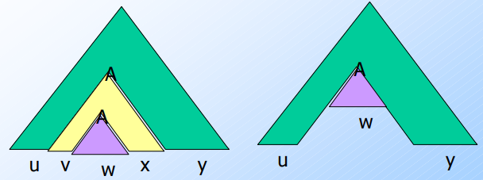
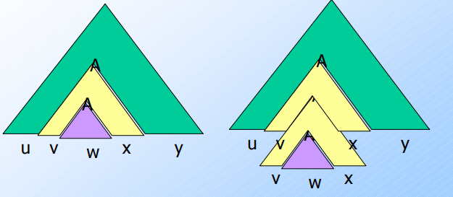
Pumping lemma for Context Free Language
Pumping 0 times
Pumping 2 times
Notes:
Pumping 0 times

Slide 7
Pumping lemma for Context Free Language
Example : L = {a^{n}b^{n}c^{n} | n ≥ 0} is not Context-free
Proof : Let us assume that L is CFL, then by Pumping Lemma should hold.
Now, let, string z = a^{k}b^{k}c^{k} ∈ L and |z| ≥ k for some k. So, by Pumping Lemma, there exists u, v, w, x, y such that :
i) |vwx| ≤ k
ii) |vx| ≥ 1
iii) for all i ≥ 0 : uv^{i}wx^{i}y ∈ L
Now, we show that for all u, v, w, x, y above points from (i) to (iii) do not hold.
If (i) and (ii) hold then z = a^{k}b^{k}c^{k}= uvwxy with |vwx| ≤ k and |vx| ≥ 1

Slide 8
Pumping lemma for Context Free Language
Here, we have five cases :
Case 1 : Suppose, vwx can contain only a’s
By (ii), vx contains aa.
Thus uwy has k b’s and k c’s but less than k a’s.
But (iii) tells us that uwy = uv⁰wx⁰y ∈ L. This gives contradiction.
Case 2 and 3 : Suppose, vwx can contain only b’s or c’s
These cases also give contradiction in similar way as case 1.
Case 4 : Suppose vwx can contain only b and c.
By (ii), vx contains single b or single c. Thus uwy has k a’s and uwy either has less than k b’s or has less than k c’s.
But (iii) tells us that uwy = uv⁰wx⁰y ∈ L. This gives contradiction.

Slide 9
Pumping lemma for Context Free Language
Case 5 : Suppose vwx can contain only a and b.
Similar to case 4 and also gives us a contradiction.
Here, in all five cases, lemma did not hold for L, so, L is not context free grammar.

Slide 10
Pumping lemma for Context Free Language
Exercise : Show that language L = { ww | w ∈ {0, 1}* } is not context free grammar.
Solution : https://www.youtube.com/watch?v=DPs8sBcIjs8

